Slide 1
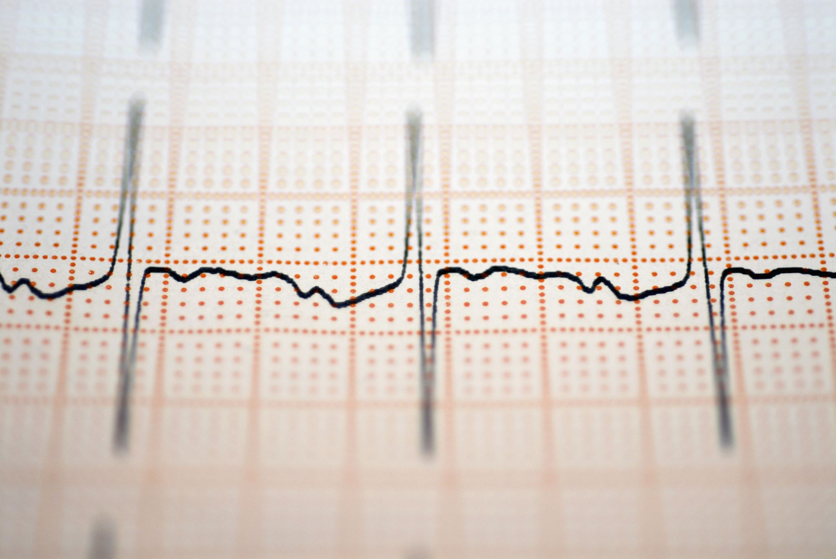
Using Machine Learning to Predict Hypertension
Tiffany Davidson
Applied Data Science and Analytics
Capstone

Slide 2
Objective
Do the odds of developing hypertension increase with certain variables? Can we use machine learning to predict if an individual will develop hypertension?

Slide 3
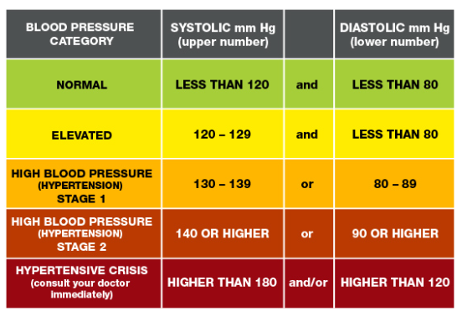
Introduction
Nearly half of adults have high blood pressure (48.1%, 119.9 million) (CDC 2023)
Hypertension is where the Systolic reading is 130 mm Hg or higher and the Diastolic reading is 80 mm Hg or higher.
Hypertension is a risk factor for cardiovascular diseases including strokes. (Appel, Lawrence, 2003).
Medication and adjusting lifestyle habits are the usual approaches to treating hypertension. (Appel, Lawrence, 2003).
https://www.heart.org/en/health-topics/high-blood-pressure/find-high-blood-pressure-tools--resources/blood-pressure-fact-sheets
Notes:
It is costly and often difficult to manage
2 Lowering blood pressure can decrease heart attacks and heart failure.
3 Increasing your intake of potassium, reducing body weight, and a reduction of salt intake are some of the recommended actions to combat hypertension.

Slide 4
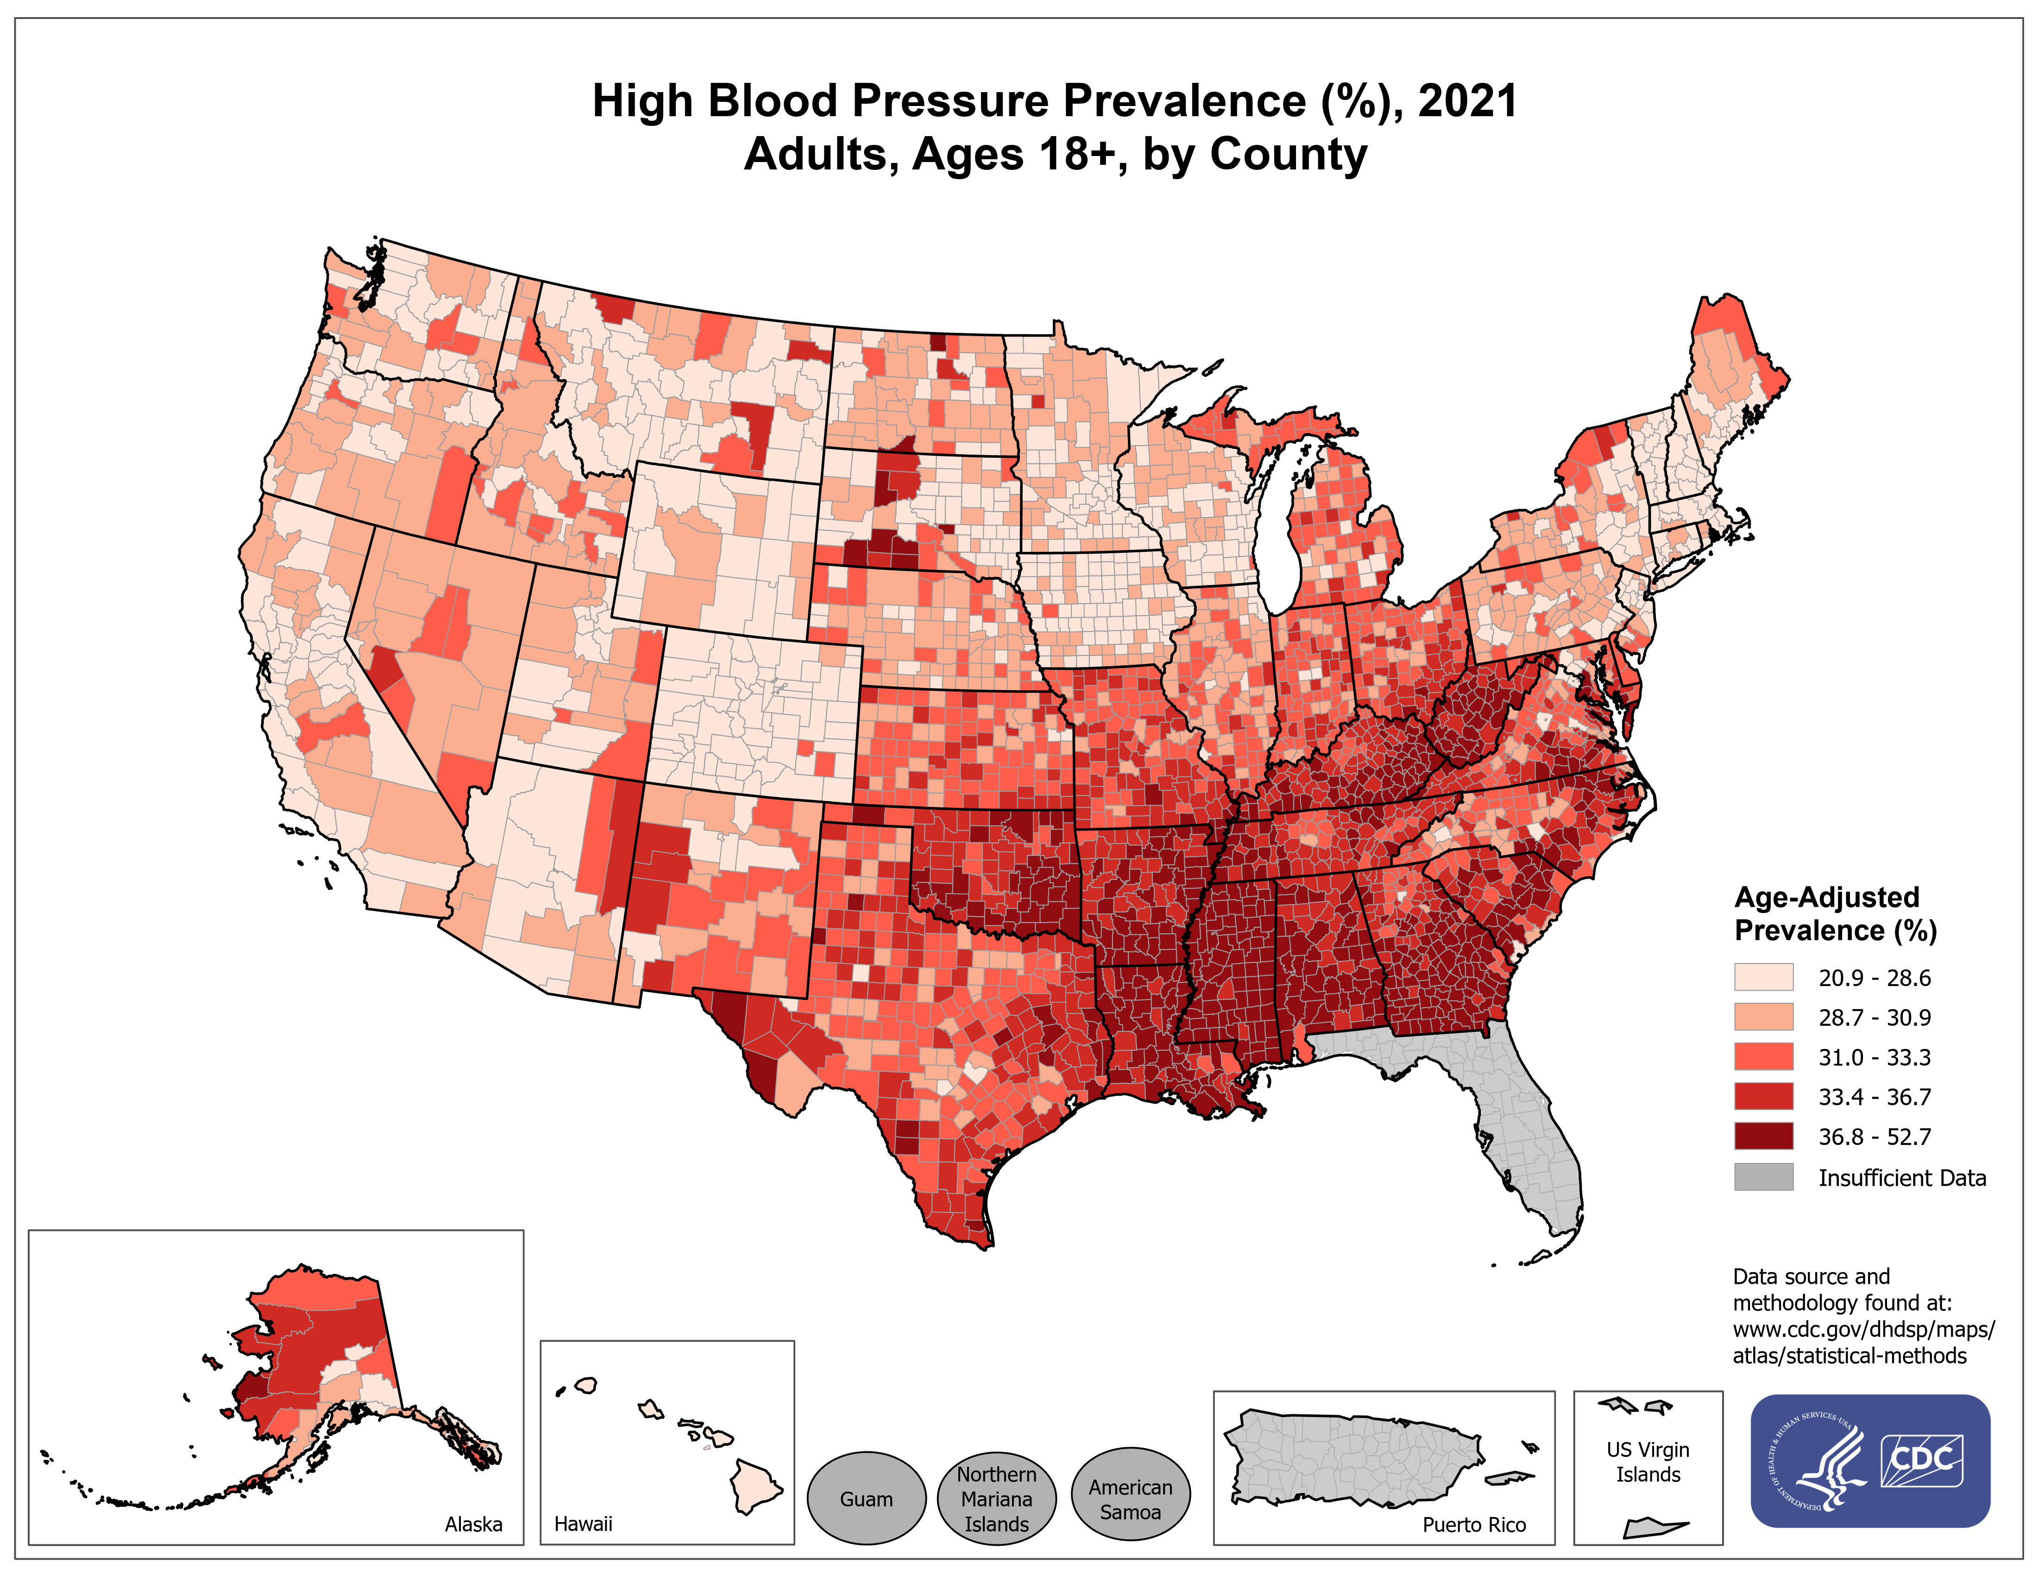
Notes:
This visual shows us the counties that have the highest concentrations of HBP in 2021 for adults over 18. We can see the pockets that are in south including Alabama, Georgia, North Carolina and more. The data was self reported which is important to note because it is likely to be understated since approximately 1 in 5 adults are unaware of their hypertension. High blood pressure is more common in non-Hispanic black adults (56%) than in non-Hispanic white adults (48%), non-Hispanic Asian adults (46%), or Hispanic adults (39%) Among those recommended to take blood pressure medication, blood pressure control is higher among non-Hispanic white adults (32%) than in non-Hispanic black adults (25%), non-Hispanic Asian adults (19%), or Hispanic adults (25%
Machine learning is technology that can help improve the speed and accuracy of healthcare providers’ work. It can be used to identify effective therapies and medications as It helps to identify patterns in data(Gideon, et al 2018)

Slide 5

Purpose of Research
Previous research has focused on hypertension as a component of cardiovascular health.
The purpose of this research is to explore what variables play a role in the likelihood of developing hypertension.
Notes:
1. I found that multiple variables such as age and lifestyle choices had been discussed but when doing nutrition counseling many times patients did not grasp the big picture.

Slide 6
Methods
Data Preparation
Data Analysis
Model Evaluation
Notes:
1. Checked for missing values. Dropped rows with NAN values. Categories for adult BMI had to be created.
Example: Underweight BMI for an adult is under 18.5(k/m^2)
The ‘Yes’ and ‘Sometimes’ responses for smoking were combined into one category as yes.
2. Created a subset of the data to concentrate on High Blood Pressure. Split the data into testing and training sets.
3. Logistic Regression, KNN, Support Vector Machine, Decision Tree, Random Forest, Gradient Boosting, AdaBoost and XG Boost. Calculate the ROC and AUC curve for the model’s performance.

Slide 7
Data
The National Health and Nutrition Examination Survey (NHANES) provided the data. NHANES is a series of studies designed to analyze the health and nutritional status of adults and children in the United States.
The datasets used came from the NHANES 2017 March 2020 Pre-Pandemic data. It contained the demographics, BMI, Blood pressure, and smoking data from that time.
The data was mined from 15,560 interviews and 14,300 examinations.
Participants with high blood pressure: 3,597
Participants without high blood pressure: 6,586
Male and female age 0-150
Notes:
1. It uses interviews coupled with physical exams. NHANES is a program under the National Center for Health Statistics (NCHS) which is part of the Centers for Disease Control and Prevention (CDC). NHANES randomly selects some, all, or none of household members from a sample of about 30 households within each selected group. The interviewer will ask questions about age, race, gender, disease history, and diet. The interviewer will present an identification badge and set up an in-home appointment
2. I chose this set to study the effects that age, smoking, BMI, gender, race, and having high cholesterol have on hypertension or high blood pressure
3. Flaws: The data included data from ages 0-150 but did not identify anyone specifically that age
The study examines the question: Can we build a model to predict a person’s likelihood of developing hypertension based on these variables?
3848 total observations of people interviewed

Slide 8
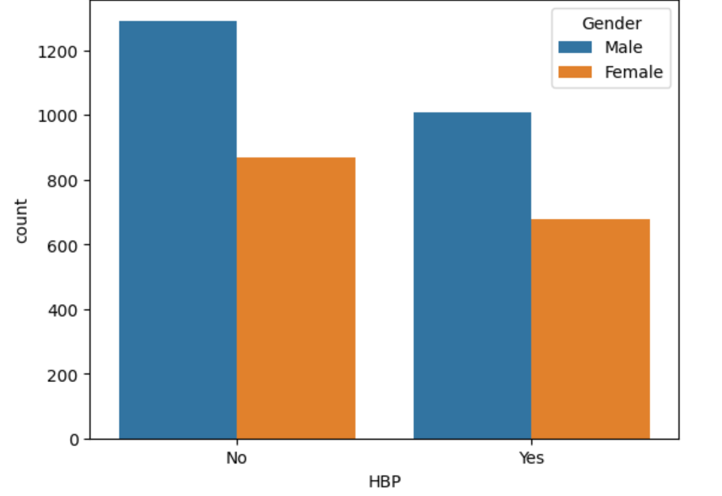
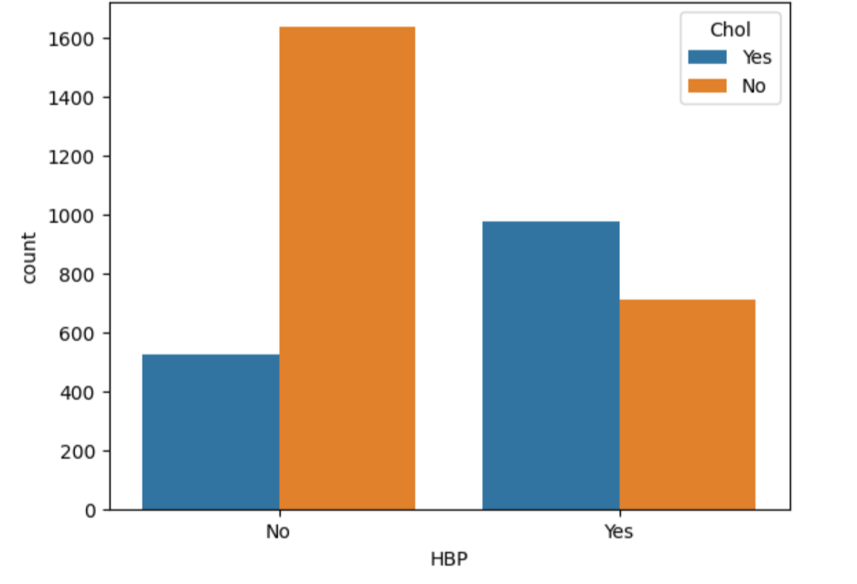
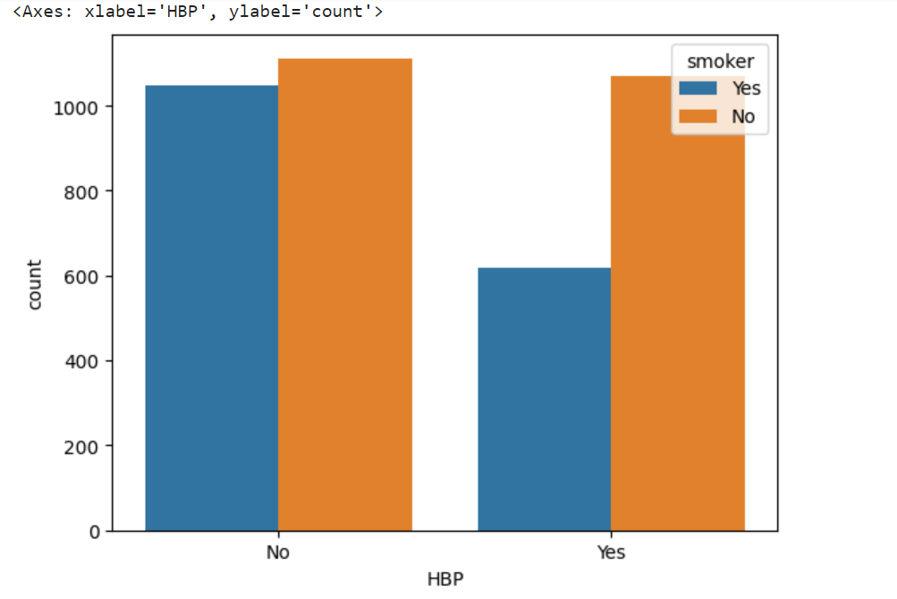
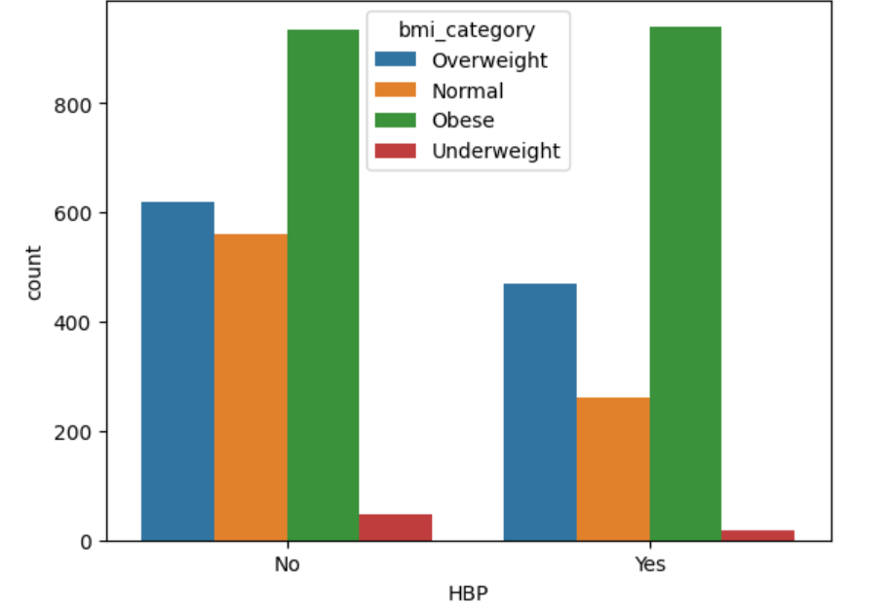
Notes:
High choles likely to have high bp. Obese likely to have high bp

Slide 9
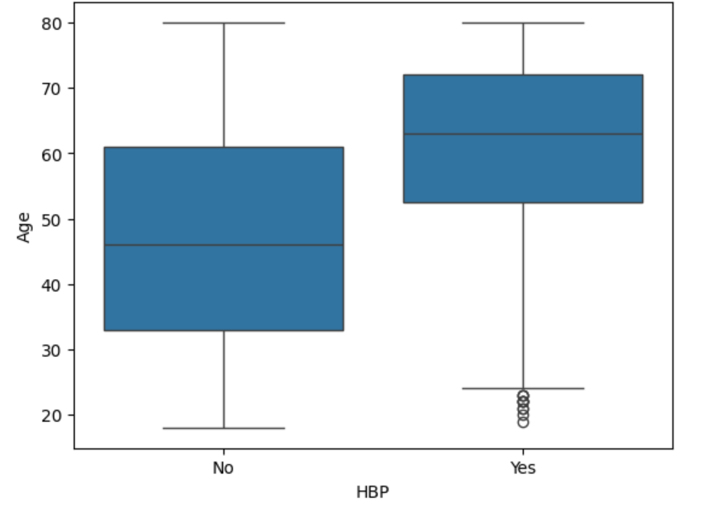
Notes:
The box plot shows that the incidences of hypertension increased as age increased.

Slide 10
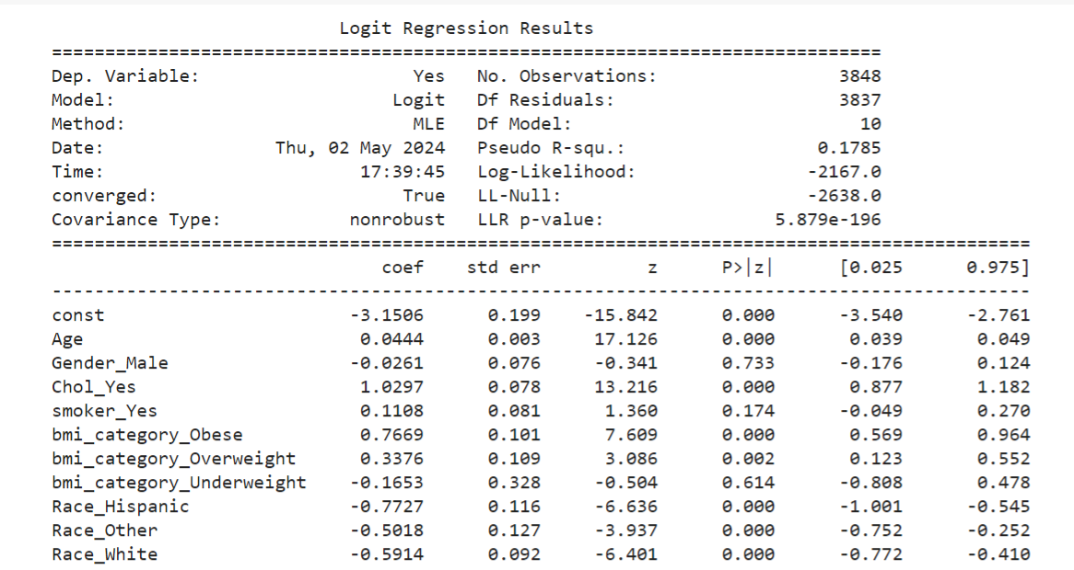
Notes:
Age , obesity and high cholesterol are significant. We will revisit
Patients who are older and have high cholesterol are also more likely to have high blood pressure.
(The lower the P value the greater the significance)
(P value is how likely you are to have found a particular set of observations if the null hypothesis were true. Null hypothesis is the claim that the effect being studied does not exist)

Slide 11
Methods: Supervised Machine Learning
Notes:
Logistic Regression, K- Nearest Neighbors, Support Vector Machine, Decision Tree, Random Forest, Gradient Boosting, AdaBoost and XG Boost

Slide 12
Model Performance on Classification Tasks
Accuracy Score Precision Recall F-1 Score Support
Logistic Regression | 0.69610389610 | 0 0.70 1 0.69 | 0.78 0.60 | 0.74 0.64 | 212 173
KNN | 0.64069264069 | 0 0.68 1 0.59 | 0.67 0.61 | 0.67 0.60 | 643 512
SVM | 0.69870129870 | 0 0.70 1 0.69 | 0.79 0.59 | 0.74 0.64 | 212 173
Decision Tree | 0.6116883116 | 0 0.65 1 0 .55 | 0.69 0.51 | 0.67 0.53 | 442 328
Random Forest | 0.63851899967 | 0 0.66 1 0.54 | 0.67 0.53 | 0.66 0.54 | 442 328
Gradient Boosting | 0.69740259740 | 0 0.74 1 0.64 | 0.72 0.66 | 0.73 0.65 | 442 328
AdaBoost | 0.64935064935 | 0.80 0.56 | 0.52 0.82 | 0.63 0.67 | 442 328
XG Boost | 0.70649350649 | 0.75 0.65 | 0.73 0.67 | 0.74 0.66 | 442 328
Notes:
The F1 score is a metric used to evaluate the performance of a model by balancing precision and recall. It measures a model’s accuracy. (Good is between 0.8 and 0.9)
Accuracy: metric that measures how often a model makes correct predictions. It's calculated by dividing the number of correct predictions by the total number of predictions made.
Precision is a metric in machine learning that measures the accuracy of a model's positive predictions:
Recall is a machine learning metric that measures how well a model can identify positive instances in a dataset.
Support is the number of actual occurrences of the class in the specified dataset. Imbalanced support in the training data may indicate structural weaknesses in the reported scores of the classifier and could indicate the need for stratified sampling or rebalancing.

Slide 13
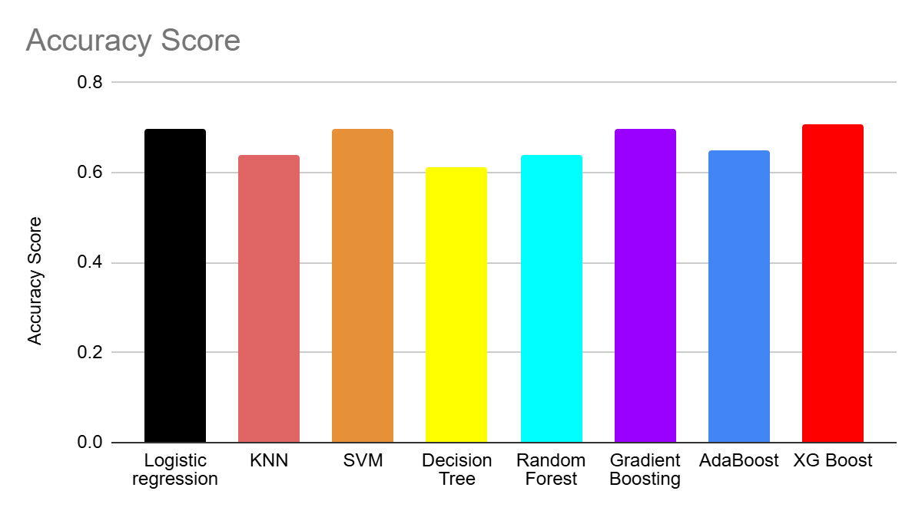
Accuracy Score
Accuracy Score
0.6961038961 Logistic regression
0.6406926407 KNN
0.6987012987 SVM
0.6116883116 Decision Tree
0.6385189997 Random Forest
0.6974025974 Gradient Boosting
0.6493506494 AdaBoost
0.7064935065 XG Boost
Notes:
The F1 score is a metric used to evaluate the performance of a model by balancing precision and recall. It measures a model’s accuracy. (Good is between 0.8 and 0.9)
Accuracy: metric that measures how often a model makes correct predictions. It's calculated by dividing the number of correct predictions by the total number of predictions made. XG boost had the highest
Precision is a metric in machine learning that measures the accuracy of a model's positive predictions:
Recall is a machine learning metric that measures how well a model can identify positive instances in a dataset.
Support is the number of actual occurrences of the class in the specified dataset. Imbalanced support in the training data may indicate structural weaknesses in the reported scores of the classifier and could indicate the need for stratified sampling or rebalancing.

Slide 14
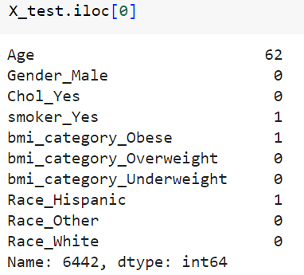
Test data
We tested a 62-year-old smoker who was obese. When the test was checked, the response was yes. This means that from the data this person has hypertension. We predict that given these features they have hypertension, so the model predicted correctly.

Slide 15
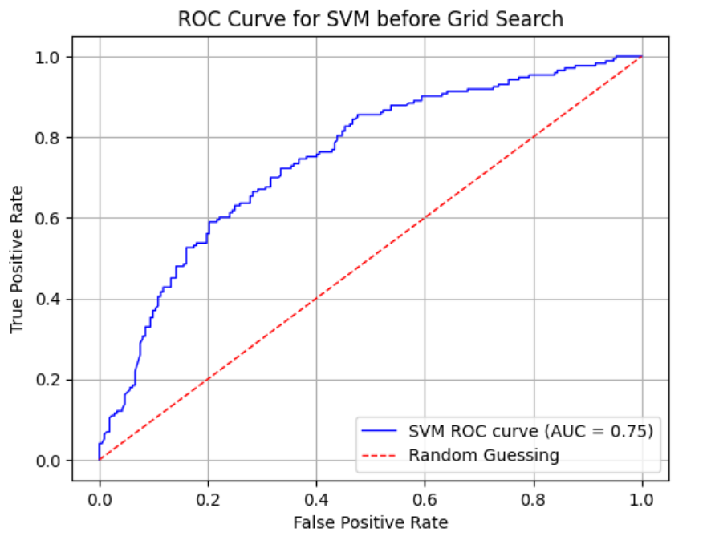
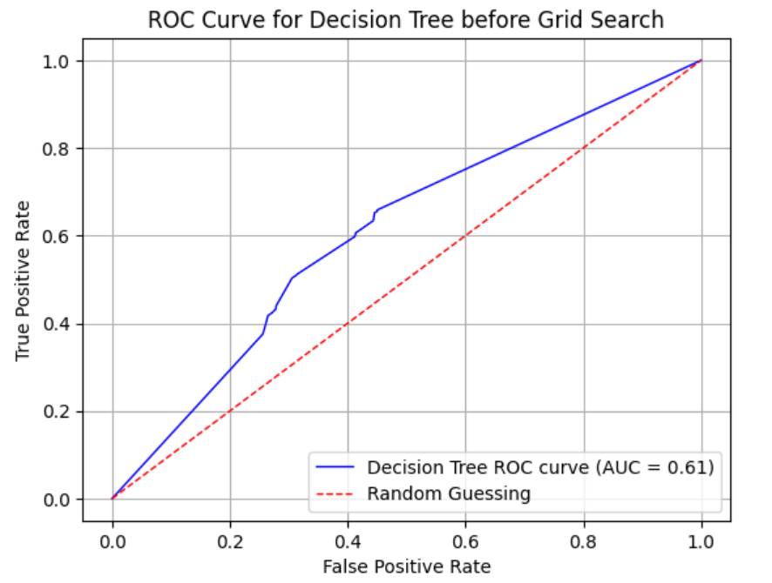
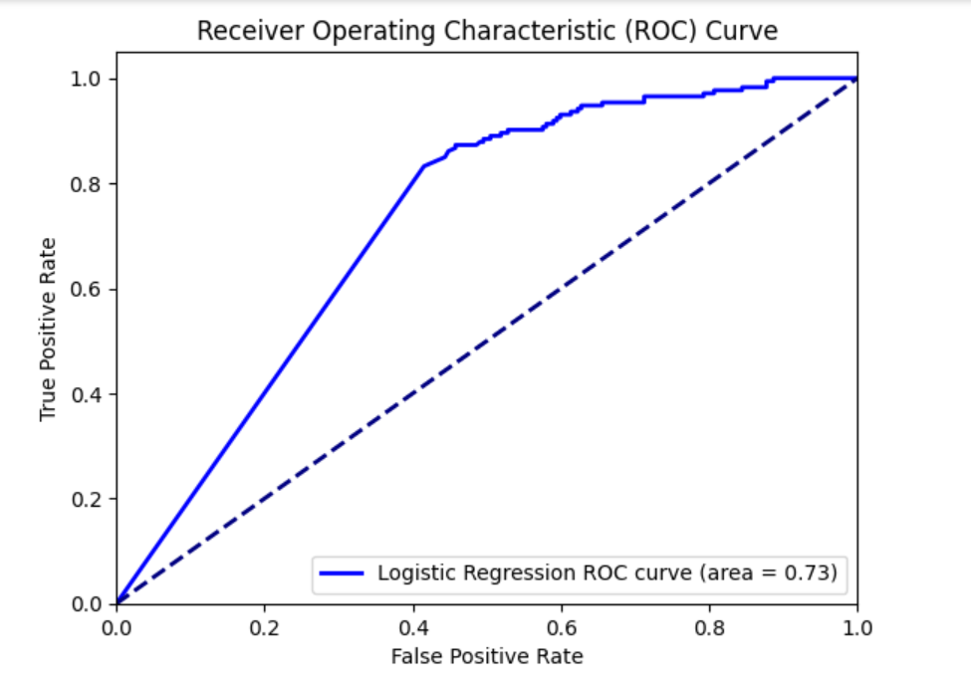
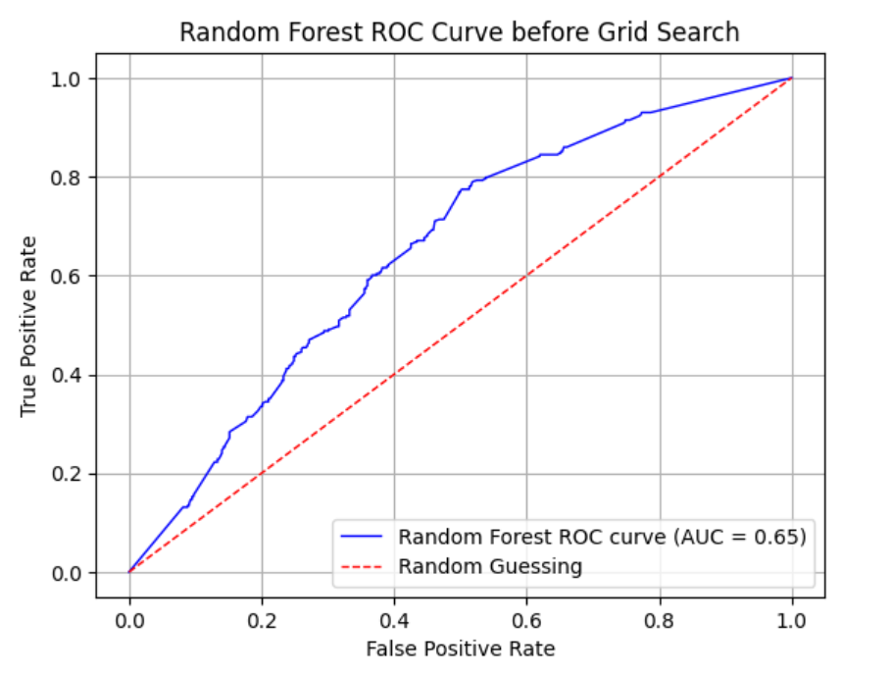
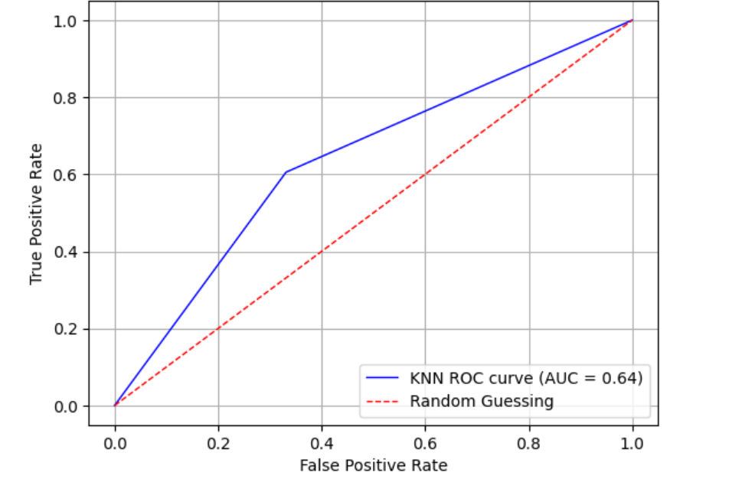
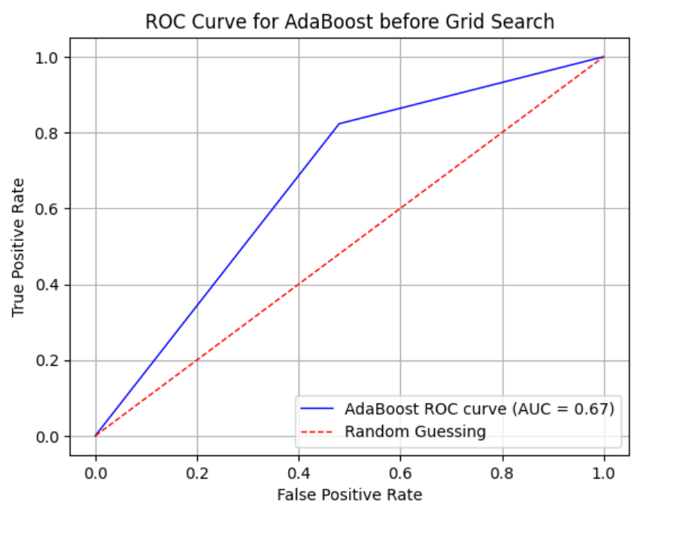
ROC Curve and Area
Notes:
1 Logistic Regression
(ROC curve is a graph that shows how well a model performs across all possible thresholds, and is used to evaluate the performance of diagnostic tests and machine learning algorithms:
A ROC curve shows the relationship between a model's true positive rate (TPR) and false positive rate (FPR) at different thresholds.)

Slide 16
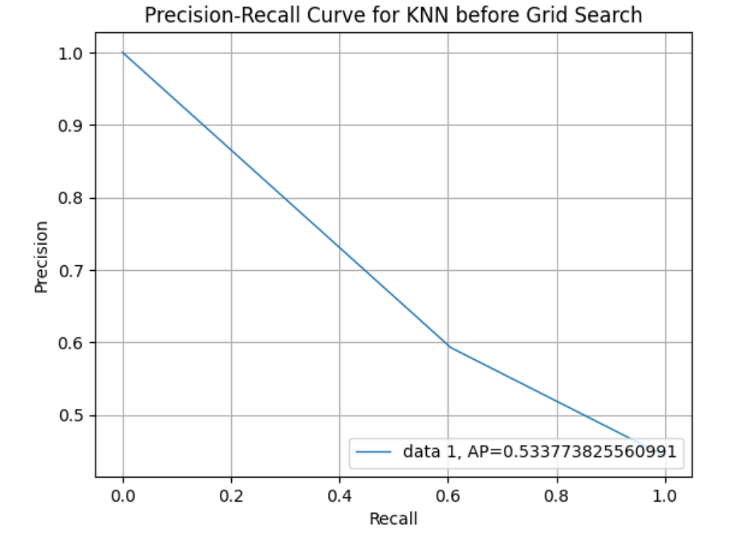
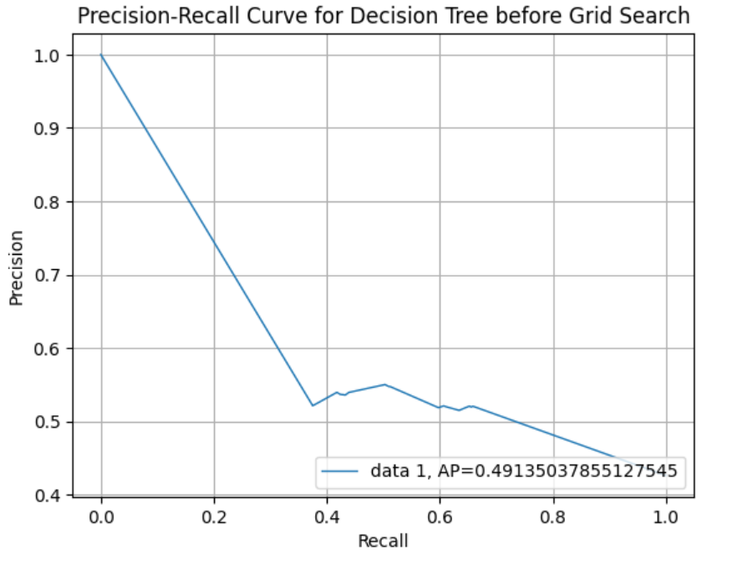
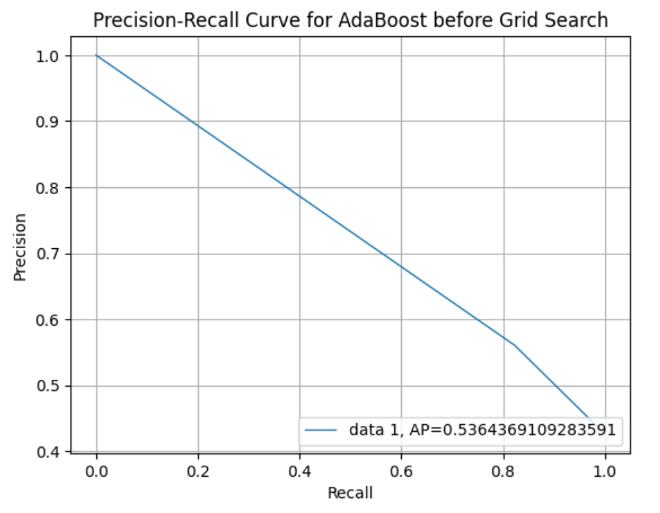
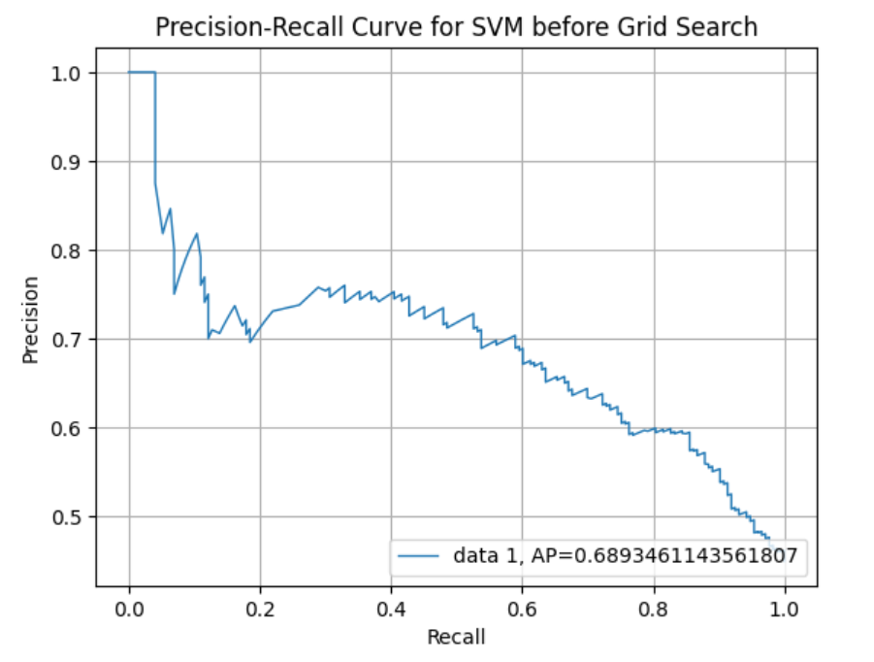
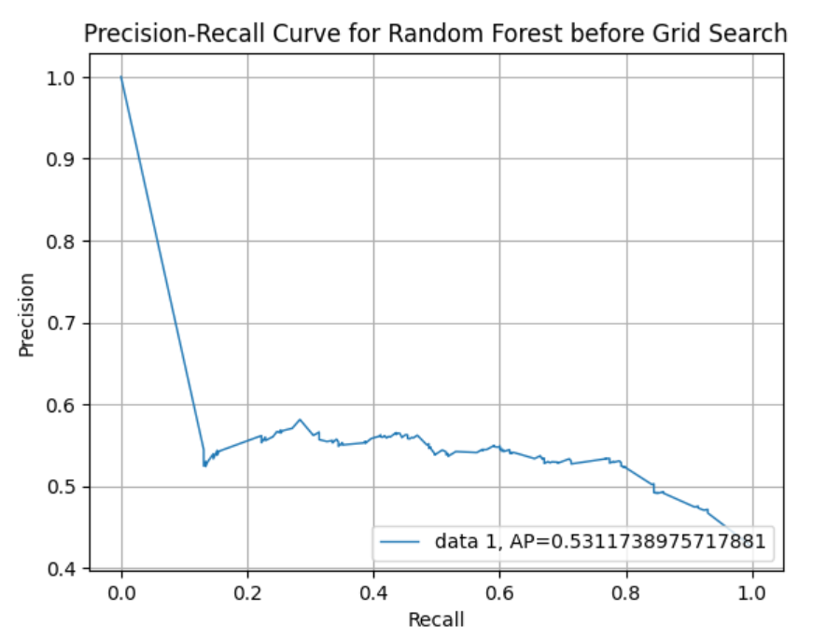
Precision-Recall Curve
Notes:
precision-recall curve plots precision as a function of recall; usually precision will decrease as the recall increases.
(Recall is a machine learning metric that measures how well a model can identify positive instances in a dataset)
(Precision is a metric in machine learning that measures the accuracy of a model's positive predictions)

Slide 17
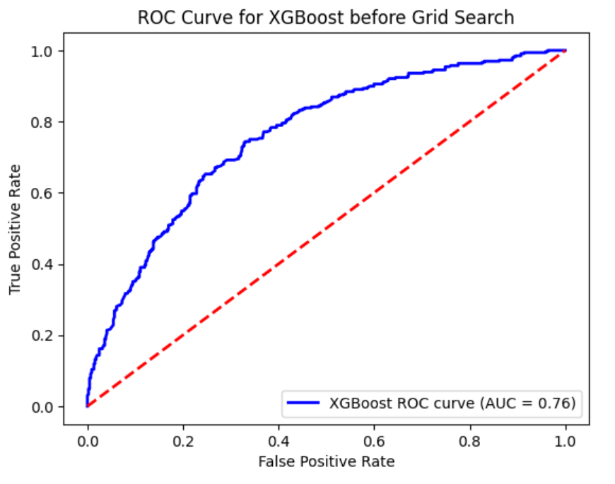
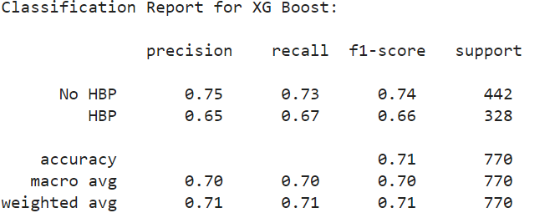
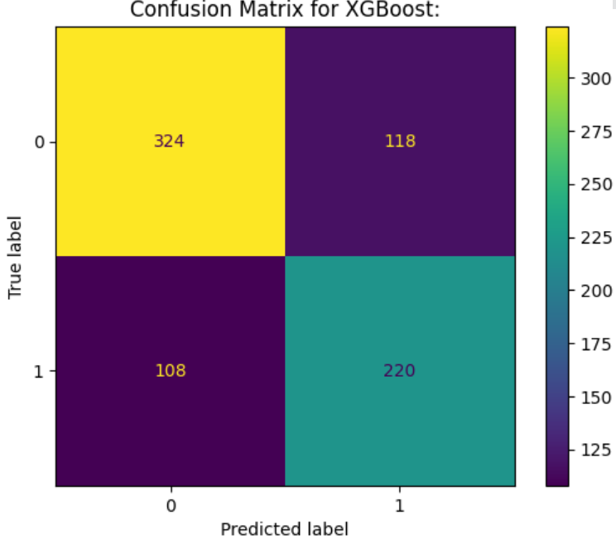
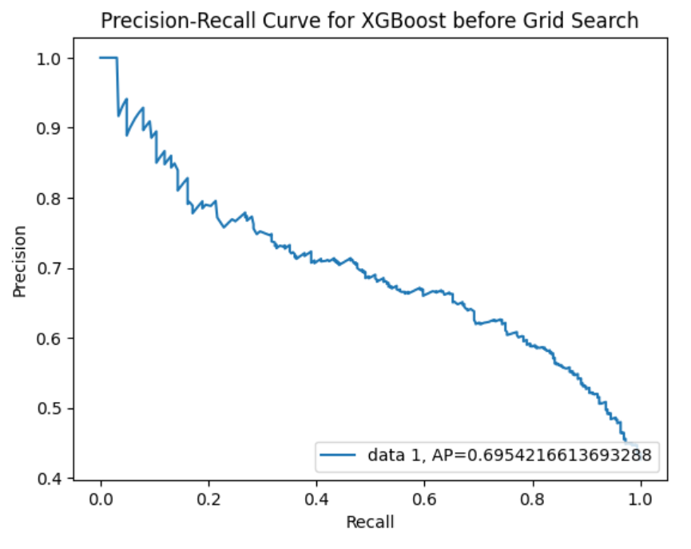
XGBoost
Notes:
Showing the confusion matrix for the best result. A confusion matrix is a matrix that summarizes the performance of a machine learning model on a set of test data. It is a means of displaying the number of accurate and inaccurate instances based on the model’s predictions. XGBoost was found to have the best prediction given the values of accuracy, F1 and ROC values.*****precision-recall curve plots precision as a function of recall; usually precision will decrease as the recall increases.
(Recall is a machine learning metric that measures how well a model can identify positive instances in a dataset)
(Precision is a metric in machine learning that measures the accuracy of a model's positive predictions)

Slide 18
Results
Previous research, “Prediction of Incident Hypertension Within the Next Year: Prospective Study Using Statewide Electronic Health Records and Machine Learning”. XGBoost was used to model build.
My results from machine learning suggest that those most likely to have hypertension were individuals who are older and have other chronic illnesses.
Results from my research suggest that there are hindrances to marginalized communities when it comes to the treatment of hypertension.
Notes:
The algorithm created classification trees and gave a final predictive risk score to each participant. They found that the population most at risk were those over the age of 50 with chronic conditions. Chengyin Y, et al 2018. utilized the data from patient electronic health records
2. They proposed a model that combined recursive feature elimination with a cross-validation method and classification algorithm. They used four classification algorithms (support vector machine (SVM), C4.5 decision tree, random forest (RF), and extreme gradient boosting (XGBoost)) to predict patient outcomes by using their optimal features subset. XGBoost was found to be the best prediction performance, and its accuracy, F1, and area under receiver operating characteristic curve (AUC) values are 94.36%, 0.875, and 0.927, respectively, using the optimal features subset. Chang W, 2019

Slide 19


Conclusion
Notes:
Conclusion: My results support current research that suggests the risk for hypertension for middle-aged and elderly people is higher. It is understood that hypertension increases with age and other comorbidities like high cholesterol. However, a clear relationship is not well documented. The underlying theme is that the increase in a person’s age also increases other risk factors that lead to hypertension. This is important information for stakeholders because it shows that the aging population is at risk for developing hypertension. For example, this can be used by lobbyists to demonstrate the importance of medical nutrition therapy in healthcare. It also proves the need for additional education on cardiovascular health at every age. CDC Hypertension Prevalence Among Adults Aged 18 and Over: United States, 2017–2018

Slide 20
Plans
I am a previous nutritional science major, and I have an interest in cardiovascular issues. In this study, I focused on race, BMI, sex, age, and smoking habits. I can further the research on what exactly it is about race that is a factor as well as the relationship between lifestyle and hypertension to include living conditions to gain a further understanding of the effects of these variables on hypertension.
Notes:
Research suggests that while there have been advancements in the fight against cardiovascular disease, Black patients still have a disproportionate amount of CVD. There are multiple reasons including racial injustices and gaps in cultural competency in health care. One very important factor in hypertension in Black patients is the low participation in medical treatment. In a study done with 376,172 participants, 50% of them did not take their medicine. This leads to a path of strokes and ultimately death (Ferdinand, Daphne, et al. 2020).
Studies like the previously referenced prove that community outreach models that address the issues faced by high-risk populations are integral and they facilitate bridging gaps in health disparities in marginalized communities.

Slide 21

References
Appel, Lawrence J. "Lifestyle modification as a means to prevent and treat high blood pressure." Journal of the American Society of Nephrology 14.suppl_2 (2003): S99-S102.
Centers for Disease Control and Prevention. Hypertension cascade: hypertension prevalence, treatment and control estimates among US adults aged 18 years and older applying the criteria from the American College of Cardiology and American Heart Association's 2017 Hypertension Guideline—NHANES 2017–March 2020. Published 2023. Accessed May 3, 2024. https://millionhearts.hhs.gov/data-reports/hypertension-prevalence.html
Chang W, Liu Y, Xiao Y, Yuan X, Xu X, Zhang S, Zhou S. A Machine-Learning-Based Prediction Method for Hypertension Outcomes Based on Medical Data. Diagnostics. 2019; 9(4):178. https://doi.org/10.3390/diagnostics9040178
Fuchs, Flávio D., and Paul K. Whelton. "High blood pressure and cardiovascular disease." Hypertension 75.2 (2020): 285-292.
Jung, C., Jung, S. H., Lee, B., Rosenberg, M., Reaven, G. M., & Kim, S. H. (2017). Relationship among age, insulin resistance, and blood pressure. Journal of the American Society of Hypertension, 11(6), 359-365.e2. https://doi.org/10.1016/j.jash.2017.04.005
Gordon T McInnes, How important is optimal blood pressure control? Clinical Therapeutics, Volume 26, Supplement A, 2004, Pages A3-A11, ISSN 0149-2918, https://doi.org/10.1016/S0149-2918(04)90140
Erin D. Michos & Sadiya S. Khan (2021) Further understanding of ideal cardiovascular health score metrics and cardiovascular disease, Expert Review of Cardiovascular Therapy, 19:7, 607-617, DOI: 10.1080/14779072.2021.1937127
Mosca, Irene, Bláithín Ní Bhuachalla, and Rose Anne Kenny. "Explaining significant differences in subjective and objective measures of cardiovascular health: evidence for the socioeconomic gradient in a population-based study." BMC cardiovascular disorders 13 (2013): 1-8.
Jonathan Myers Exercise and Cardiovascular Health Originally published7 Jan 2003 https://doi.org/10.1161/01.CIR.0000048890.59383.8DCirculation. 2003;107:e2–e5
Koren, G., Nordon, G., Radinsky, K., & Shalev, V. (2018, April 24). Darrell R. Abernethy (1949‐2017) - 2018 - pharmacology research & perspectives - wiley online library. Machine learning of big data in gaining insight into successful treatment of hypertension. https://bpspubs.onlinelibrary.wiley.com/doi/full/10.1002/prp2.382
Vasan RS, Beiser A, Seshadri S, et al. Residual Lifetime Risk for Developing Hypertension in Middle-aged Women and Men: The Framingham Heart Study. JAMA. 2002;287(8):1003–1010. doi:10.1001/jama.287.8.1003
Prediction of Incident Hypertension Within the Next Year: Prospective Study Using Statewide Electronic Health Records and Machine Learning Ye C, Fu T, Hao S, Zhang Y, Wang O, Jin B, Xia M, Liu M, Zhou X, Wu Q, Guo Y, Zhu C, Li Y, Culver D,Alfreds S, Stearns F, Sylvester K, Widen E, McElhinney D, Ling X
J Med Internet Res 2018;20(1):e22
URL: https://www.jmir.org/2018/1/e22
DOI: 10.2196/jmir.9268

